Slide 1
Fuel and thermochemistry

Slide 2
Thermochemical Equations
A thermochemical equation is the chemical equation for a reaction (including phase labels) in which the equation is given a molar interpretation, and the enthalpy of reaction for these molar amounts is written directly after the equation.
Notes:
3

Slide 3
Hess’s Law
overall enthalpy change for a particular reaction is the same regardless of route.

Slide 4
Hess’s Law
For example, suppose you are given the following data:
Could you use these data to obtain the enthalpy change for the following reaction?
Notes:
3

Slide 5
Using Standard Enthalpy Values
H₂O(g) + C(graphite) --> H₂(g) + CO(g)
From reference books we find
H₂(g) + 1/2 O₂(g) --> H₂O(g) ∆H_{f}˚ = - 242 kJ/mol
C(s) + 1/2 O₂(g) --> CO(g) ∆H_{f}˚ = - 111 kJ/mol

Slide 6
Using Standard Enthalpy Values
H₂O(g) --> H₂(g) + 1/2 O₂(g) ∆Hº = +242 kJ
C(s) + 1/2 O₂(g) --> CO(g) ∆Hº = -111 kJ
--------------------------------------------------------------------------------
H₂O(g) + C(graphite) --> H₂(g) + CO(g)
∆Hº_{net} = +131 kJ
To convert 1 mol of water to 1 mol each of H₂ and CO requires 131 kJ of energy.
The “water gas” reaction is ENDOthermic.

Slide 7

Using Standard Enthalpy Values
Calculate ∆H of reaction?
In general, when ALL enthalpies of formation are known:
∆Hº_{rxn} = Σ ∆H_{f}º (products) - Σ ∆H_{f}º (reactants)
Remember that ∆ always = final – initial

Slide 8
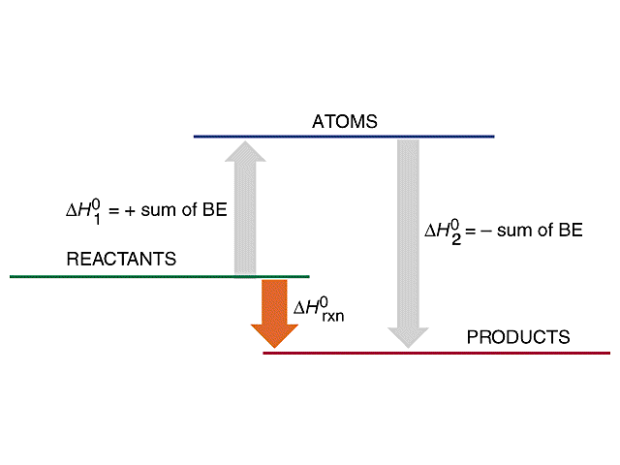
The Bond Enthalpy is the energy required to break a chemical bond. It is usually expressed in units of kJ mol⁻¹, measured at 298 K. The exact bond enthalpy of a particular chemical bond depends upon the molecular environment in which the bond exists. Therefore, bond enthalpy values given in chemical data books are averaged values.
http://kentchemistry.com/links/Kinetics/BondEnergy.htm

Slide 9
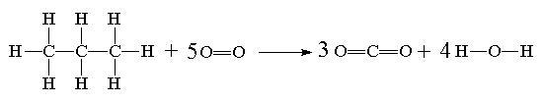
The complete combustion of propane can be represented by the following equation:
or we could redraw it to represent the bonds present:
Bond Type | Average bond enthalpy kJ/mol
C-H | +413
C-C | +347
O=O | +498
C=O | +805
H-O | +464
Total endothermic change for bond breaking: 8xC-H 2xC-C 5xO=O = (8 x +413) + 2(+347) + 5(+498) | Total exothermic change for bond forming: 6 x C=O 8 x O-H = (6 x -805) + (8 x -464) | ΔH= [(8x413)+(2x347)+(5x498)] --- [(6x805)+(8x464)]= - 2054 kJ mol⁻¹

Slide 10
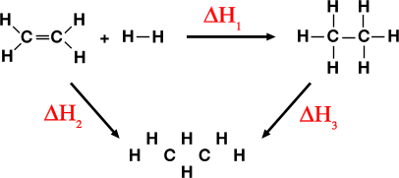
Enthalpy of reaction from bond enthalpies
Calculate the enthalpy change for the hydrogenation of ethene

Slide 11
Enthalpy of reaction from bond enthalpies
Calculate the enthalpy change for the hydrogenation of ethene
ΔΗ₂ 1 x C=C bond @ 611 = 611 kJ
4 x C-H bonds @ 413 = 1652 kJ
1 x H-H bond @ 436 = 436 kJ
Total energy to break bonds of reactants = 2699 kJ

Slide 12
Enthalpy of reaction from bond enthalpies
Calculate the enthalpy change for the hydrogenation of ethene
ΔΗ₂ 1 x C=C bond @ 611 = 611 kJ
4 x C-H bonds @ 413 = 1652 kJ
1 x H-H bond @ 436 = 436 kJ
Total energy to break bonds of reactants = 2699 kJ
ΔΗ₃ 1 x C-C bond @ 346 = 346 kJ
6 x C-H bonds @ 413 = 2478 kJ
Total energy to break bonds of products = 2824 kJ
Applying Hess’s Law ΔΗ₁ = ΔΗ₂ – ΔΗ₃ = (2699 – 2824) = – 125 kJ

Slide 13
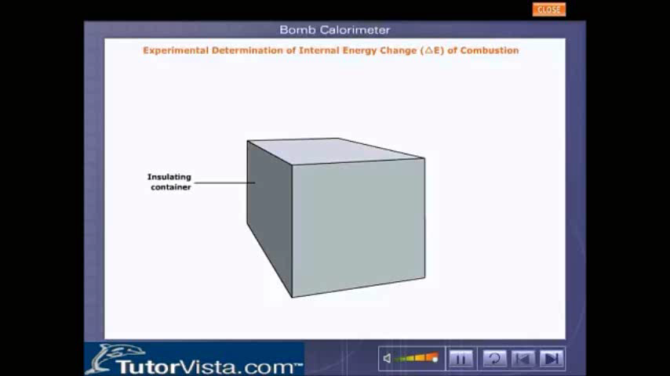
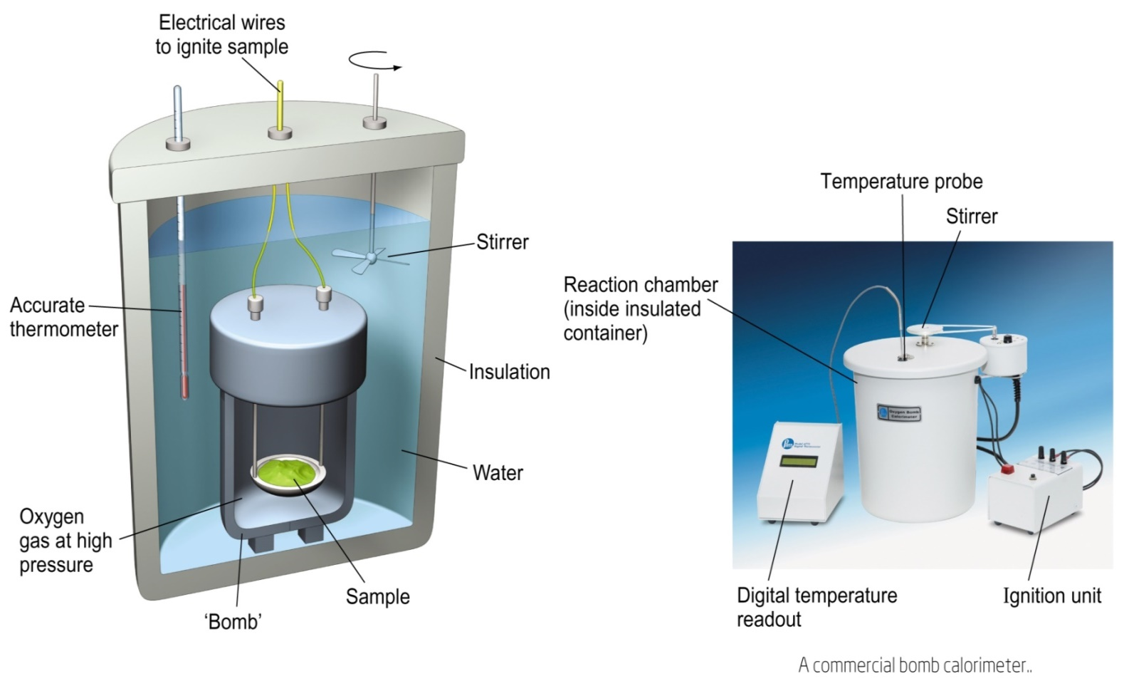
Measuring Heats of Reaction
Constant Volume “Bomb” Calorimeter
Burn combustible sample.
Measure heat evolved in a reaction.
Derive ∆U for reaction.
CALORIMETRY

Slide 14
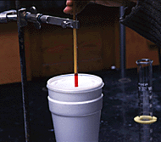
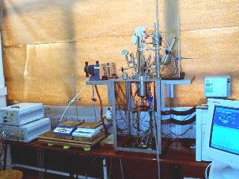
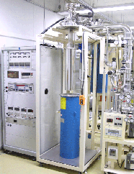

Slide 15
FUELS
A combustible substance which on proper burning in air liberates huge amount of heat, that can be used economically for domestic and industrial purposes
e.g. coke, coal, charcoal, petroleum diesel etc
Notes:
‹#›

Slide 16
CLASSIFICATION
Fuels
Primary or natural Secondary or derived
Solid liquid Gaseous
Wood crude oil Natural gas
Coal
Dung
solid liquid gaseous
coke tar coal gas
charcoal kerosene water gas
coke diesel oil gas
briquette Petrol bio gas
LPG

Slide 17
CHARACTERISTICS OF A GOOD FUEL 1. High Calorific value 2. Low moisture contents 3. Moderate ignition temperature 4. Low ash content 5. No harmful combustion product formation 6. Moderate rate of combustion 7. low cost 8. Easy to transport

Slide 18
Comparision between solid, liquid and gaseous fuels
Properties | Solid fuels | Liquid fuels | Gaseous fuels
Price | Cheap and easily available | Costly | Costly except natural gas
Transport and storage | easy | Transported easily though pipelines but must be stored in closed containers carefully | Transported through pipelines and are stored in leak proof tanks

Slide 19
Combustion | slow | quick | Very fast
Fire hazards | Less risk | Greater risk | Even greater than liquid fuels
Smoke and ash | Always produced and reduces calorific value | Ash is not produced but smoke is produced | Neither ash nor smoke is produced
Calorific value | least | higher | Highest

Slide 20
CALORIFIC VALUE 1g compound + O₂ CO₂ +H₂O, ∆H= ? Here, ∆H = calorific value Definition: Total amount of heat liberated when unit mass or unit volume of fuel is burnt in presence of excess supply of oxygen. UNITS 1. Calorie: for 1g of water by 1ºC 1calorie = 4.184 Joule = 4.185 x 10⁷ ergs 2. K.Calorie: for 1 kg of water by 1ºC 3. British Thermal Unit (B.Th.U.): for 1 pound of water by 1ºF 4. Centigrade heat unit (C.H.U.): for 1 pound by 1ºC 1k.cal = 1000Cal = 3.968 B.Th.U. = 2.2 C.H.U.

Slide 21
GROSS OR HIGHER CALORIFIC VALUE (HCV) The amount of heat liberated when a unit quantity of a fuel is completely burnt in presence of excess supply of oxygen and the products of combustion are allowed to cool at room temperature. A + O₂ CO₂ + H₂O_{(v)} , ∆H₁=x H₂O_{(v)} H₂O_{(l)} , ∆H₂ = y (y = latent heat of steam) So, HCV = Total ∆H = x+ y

Slide 22
LOWER OR NET CALORIFIC VALUE (LCV or NCV) The amount of heat liberated when a unit quantity of a fuel is completely burnt in excess supply of oxygen and the products of combustion are allowed to escape in the atmosphere. A + O₂ CO₂ + H₂O_{(v)} , ∆H₁=x LCV = x = HCV – latent heat of water vapours formed = HCV – 0.09 x H x 587 cal/g (where, H = % of hydrogen in the fuel)

Slide 23
Differences between Gross and Net calorific value
S.No. | GCV | NCV
1 | The amount of heat released when unit quantity of fuel is burnt completely and the products of combustion are allowed to cool at room temperature. | The amount of heat released when unit quantity of fuel is burnt completely and the products of combustion are allowed to escape at room temp.
2 | Latent heat of condensation of steam is included | Latent heat of condensation of steam is not included
3 | It is also known as Higher Calorific Value | It is also known as Lower Calorific Value
4 | Having more value than NCV | Having lesser value than GCV

Slide 24
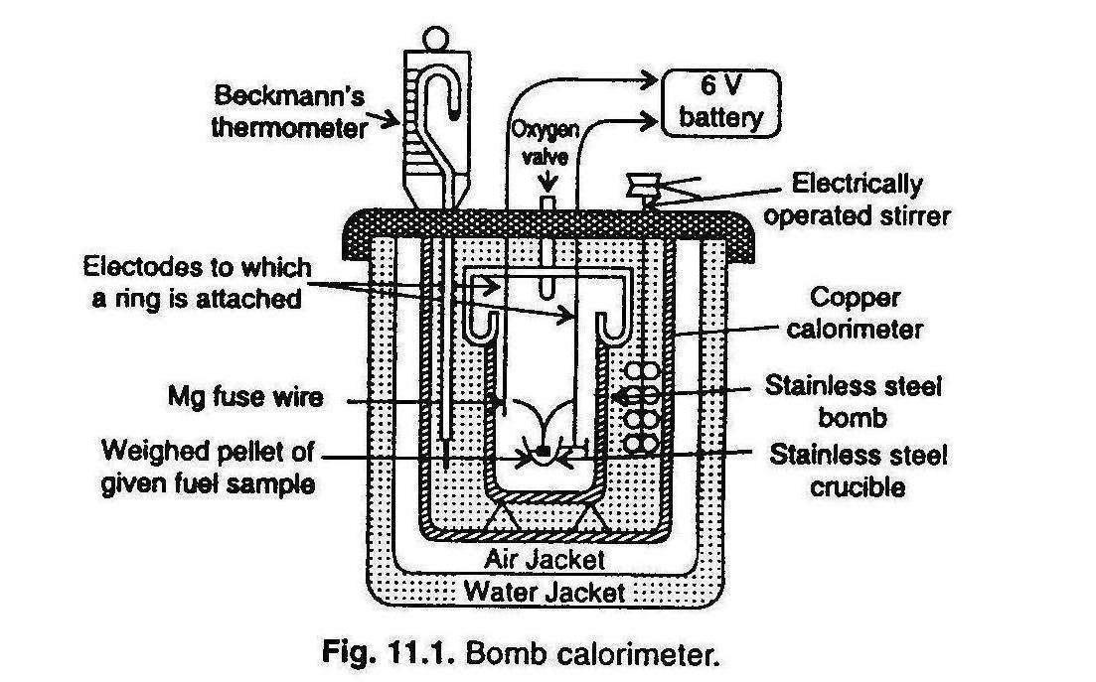
BOMB CALORIMETER

Slide 25
CALCULATION mass of fuel taken in calorimeter = m g mass of water taken in calorimeter=Wg water equivalent of calorimeter bomb, thermometer, stirrer etc = A g Initial temp. of water in calorometer = t₁ final temp. of water in calorimeter = t₂ higher calorific value = HCV heat liberated by burning of fuel = m x HCV heat gained by water, calorimeter etc = (W+A)(t₂-t₁) heat liberated = heat gained m x HCV = (W + A)(t₂-t₁) HCV = (W+A)(t₂-t₁) cal/g or kcal/kg m

Slide 26
Let H be the % of hydrogen in the fuel, then
LCV = HCV – 0.09H x 587 cal/g or kcal/kg
Corrections
(i) Fuse wire correction (C_{F}) : should be subtracted. (heat given out by ignition of the fuse wire used)
(ii) Cotton thread correction (C_{CT}) : should be subtracted.
(iii) Acid correction (C_{A}) : should be subtracted. (Fuel containing S and N are oxidized under high press and temp; S+H₂+2O₂= H₂SO₄ + Heat, 3N+H₂+3O₂= 2 HNO₃+Heat)
(iv) Cooling correction (C_{C}) : should be added. (Time taken to cool the water in calorimeter from maximum to room temperature is noted)
So, HCV = (W + A)(t₂-t₁+C_{C})-(C_{A}+C_{F}+C_{CT}) cal/g
m
Notes:
‹#›

Slide 27
PROBLEM
A sample of coal contains: C = 93%, H = 6% and ash = 1%. The following data were obtained when the above coal was tested in a bomb calorimeter:
Weight of cool burnt = 0.92 g
Weight of water taken = 550 g
Water equivalent of bomb and calorimeter = 2,200 g
Rise in temperature = 2.42°C
Fuse wire correct = 10.0 cal
Acid correction = 50.0 cal
Calculate the gross and net calorific value of cool, assuming that the latent heat of condensation of steam is 580 cal/g.
Answer: GCV = 7168.47 cal/g NCV = 6855.27 cal/g

Slide 28
Theoretical calculation of minimum air requirement for combustion of a fuel
Combustion is the process of burning any combustible substance in the presence of oxygen, which liberates energy in the form of heat and light. For efficient combustion, it is essential that the fuel must be brought into intimate contact with sufficient quantity of air or oxygen.
The combustible substance usually present in fuels, which enter into the combustion, are mainly C, H, S and O. But N, CO₂ and ash are incombustible matters present in the fuel, do not take any oxygen during combustion.
For the complete combustion of a given quantity of fuel can be calculated by considering the following point. Substances always combine in definite proportions, which are determined by the molecular weights of the substances.
‹#›

Slide 29
i) Combustion of carbon
C + O₂ CO₂
12 32 44 (by weight)
1 1 1 (by volume)
12 parts by weight-of carbon requires 32 parts by weight of oxygen for complete combustion. 'C' parts by weight of carbon requires == 32 C /12 == 8/3 C
ii) Combustion of hydrogen
. When oxygen is present in the fuel, it always combines with hydrogen. The combined hydrogen does not take part in combustion reaction. Therefore, the quantity of combined hydrogen must be deduced from the total hydrogen in the fuel.
2H₂ + O₂ 2H₂O
4 32 36 (by weight)
2 1 2 (by volume)
(H- O/8) parts by weight of hydrogen requires = (H - O/8) X 32
4
= 8 (H- O/8)
= 8H - O
‹#›

Slide 30
4 parts by weight of H2 requires 32 parts by weight O2 (or) 2 parts by volume of H2 require 1 part by volume of O2
There fore ‘H’ parts by weight of hydrogen require 32x H parts by weight of O2. 4
iii) Combustion of carbon monoxide
CO + ½ O₂ CO₂
28 16 (by weight)
1 0.5 (by volume)
1 volume of CO requires 0.5 volume of oxygen.
28 parts by weight-of carbon monoxide requires 16 parts by weight of oxygen for complete combustion.
iv) Combustion of sulphur
S + O₂ SO₂
32 (by weight)
1 (by volume)
1 volume of 'S' requires 1 volume of oxygen.
32 parts by weight-of sulphur requires 32 parts by weight of oxygen for complete combustion.
‘S' parts by weight of carbon requires == 32 S /32 == S
‹#›

Slide 31
v) Combustion of methane
CH₄ + 2O₂ CO₂ + 2 H₂O
16 64 (by weight)
1 2 (by volume)
If the fuel contains mainly C, H, S and O then
Theoretical amount of oxygen required for complete combustion of 1 kg of fuel is given by the equation,
{32/12 x C + 8[H – O/8] + S} kg
C, H and S are masses of carbon. Hydrogen and sulphur respectively per kg of the fuel. Since 1 kg of air-contains 23%of oxygen by weight, the amount of air required theoretically to burn 1 kg of fuel completely is given by equation.
100/23 {32/12 x C + 8[H – O/8] + S} Kg
‹#›

Slide 32
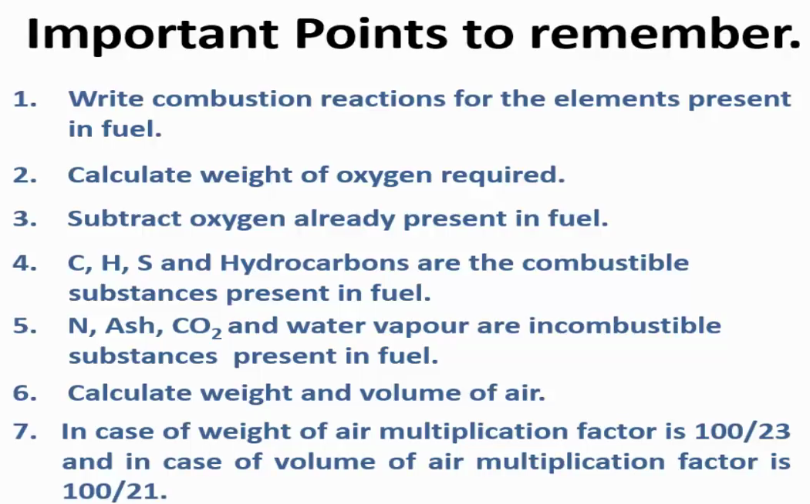

Slide 33
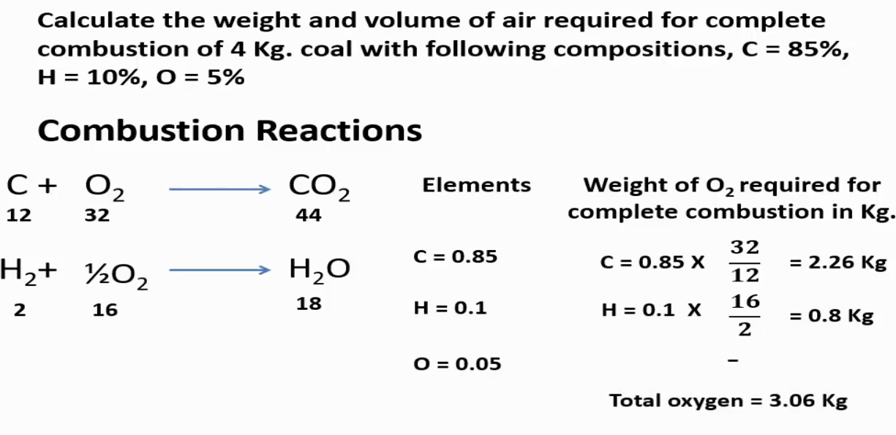
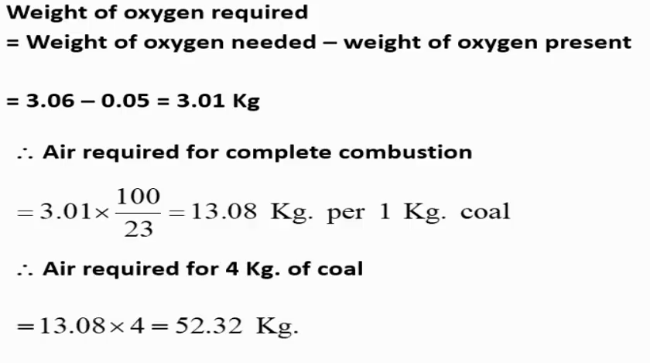

Slide 34
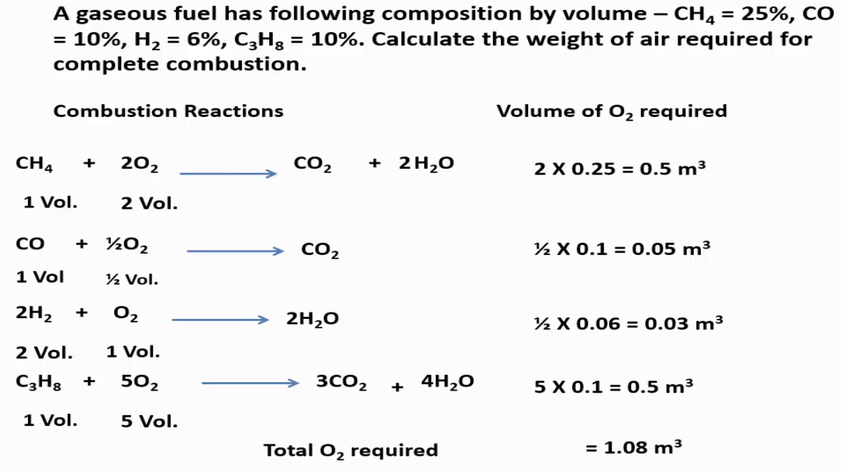

Slide 35
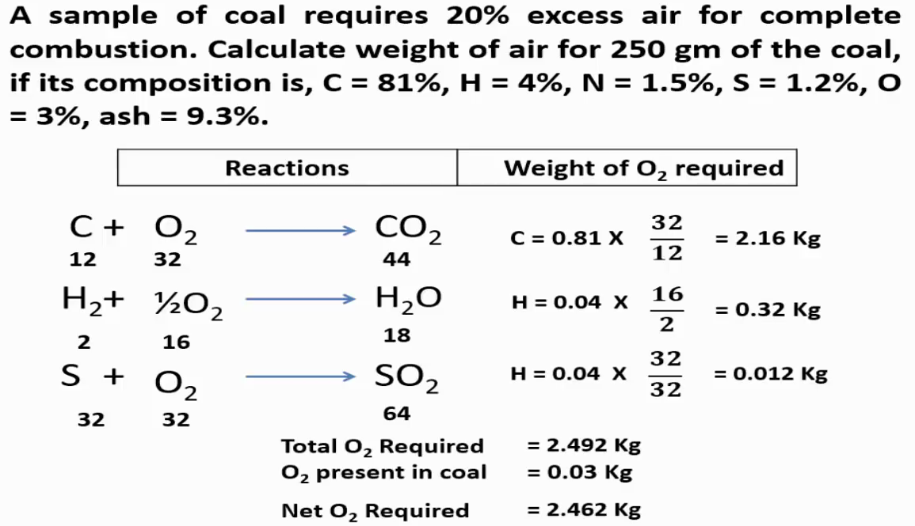

Slide 36
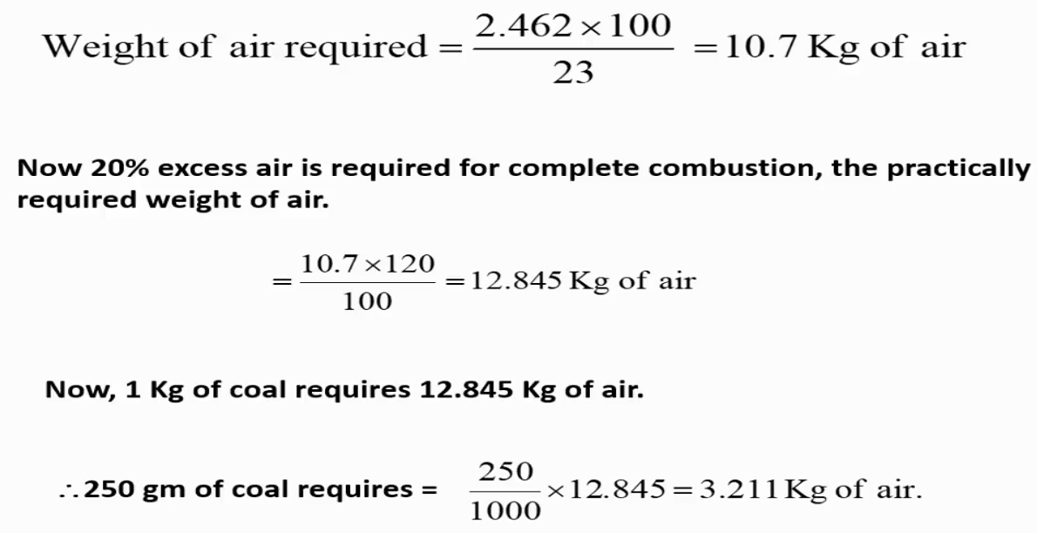

Slide 37
A sample containing 92% C, 5% H,3% ash and gives the following data on combustion:
Wt of coal burnt – .95 gm
Wt of water taken – 700 gm
Water equivalents – 2000gm
Rise in temperature – 2.48 gm
Cooling correction – .02⁰C
Fuse wire correction – 10 cal
Acid correction – 60 cal Calculate GCV and NCV of coal.
(Ans : 7031.6cal/g, 6770.6cal/g)

Slide 38
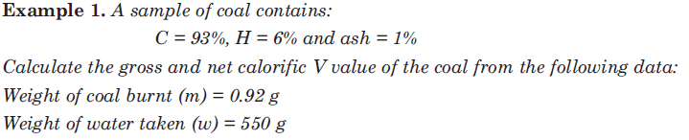
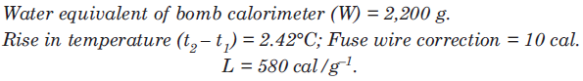
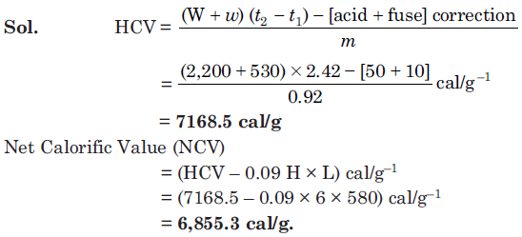

Slide 39
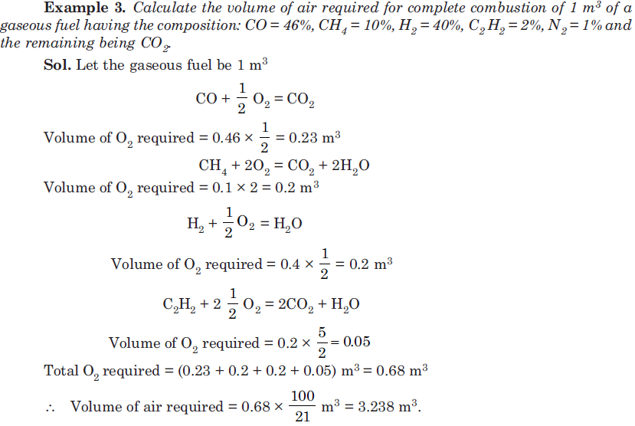
Examples:

Slide 40
Calculate the minimum wt of air required for complete combustion of 1 Kg of fuel containing; 90% C, 3.5% H, 3% O, .5% S, 1% H₂O, .5% N and rest ash.
( Ans: 11.543 Kg)

Slide 41
A gas has the following composition by volume: H₂ = 10%, CH₄ = 14%, O₂ = 14%, N₂ = 40%. If 25% excess air is used, find the weight of air actually supplied per meter³ of this gas.
(Ans: 922.8 g)

Slide 42
COAL SAMPLE ANALYSIS
Proximate analysis
Ultimate analysis

Slide 43
ANALYSIS OF COAL SAMPLE
Coal is a highly carbonaceous matter that has been formed from fossilised remains of plants under suitable conditions.
ANALYSIS- 2 types
1. PROXIMATE ANALYSIS - includes the determination of moisture, volatile matter, ash and fixed carbon
Moisture: at 110ºC for an hour
% of moisture = wt of moisture x 100
wt of coal sample

Slide 44
(ii) Volatile matter : at 925+/- 25ºC for 7 minutes
% of volatile matter = Loss of wt due to removal of volatile matter x 100
wt of coal sample taken
(iii) Ash content: at 700-750ºC for half an hour
% of ash = wt of ash x 100
wt of coal sample taken
(iv) Fixed carbon = 100- % of (moisture + ash + volatile matter)
SIGNIFICANCE:
Higher % of fixed carbon Higher calorific value better fuel

Slide 45
PROBLEM
A sample of coal was analysed as follows:
Exactly 2.5g was weighed in a silica crucible. After heating for one hour at 110°C, the residue weighed 2.415g. The crucible next was covered with a vented lid and strongly heated for exactly 7 minutes at 950±20°C. The residue weighed 1.528g. The crucible was then heated without cover, until a constant weight was obtained. The last residue was found to weigh 0.245g. Calculate the % results of the above analysis.
ANSWER
Moisture = 3.4% Volatile matter= 35.48%
Ash = 9.8% Fixed Carbon = 51.32%

Slide 46
ULTIMATE ANALYSIS OF COAL
Includes the estimation of % of elements in the fuel
(i)Determination of C & H
C + O₂ CO₂
H₂ + O₂ H₂O
2KOH + CO₂ K₂CO₃ + H₂O
CaCl₂ + 7H₂O CaCl₂.7H₂O

Slide 47
% of C =Increase in the wt of KOH tube x 12 x 100
Wt of coal sample taken x 44
% of H = Increase in the wt of CaCl₂ tube x 2 x 100
Wt of coal sample taken x 18

Slide 48
(ii) Determination of N: Kjeldahl method
Fuel(W g) + H₂SO₄ (NH₄)₂SO₄
(NH₄)₂SO₄ + NaOH NH₃ +Na₂SO₄ + H₂O
Known amount
of H2SO4
NH₃ is neutralised Excess H2SO4
(Titrated against alkali)

Slide 49
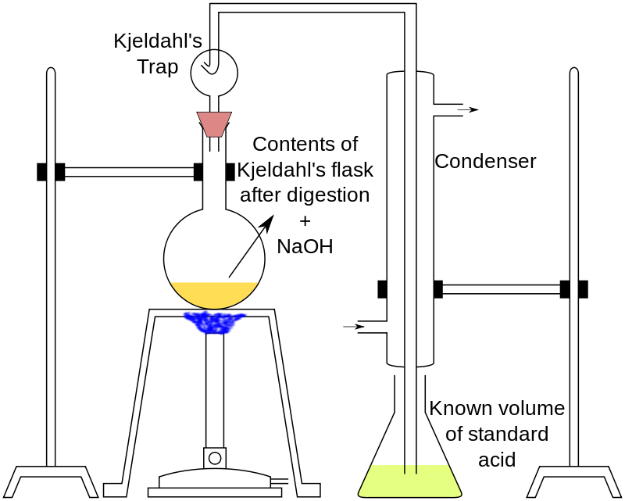
Determination of N: Kjeldahl method
The Kjeldahl method consists of three steps:
Digestion: about 1 g of fuel – heated with conc H₂SO₄ along with K₂SO₄/ CuSO₄ as catalyst in a long necked flask.
Fuel(W g) + H₂SO₄ (NH₄)₂SO₄
2. Distillation: When clear solution is obtained (all N converted to (NH₄)₂SO₄), it is treated with excess NaOH to liberate NH₃
(NH₄)₂SO₄ + NaOH NH₃ +Na₂SO₄ + H₂O
3. Titration:
NH₃ thus produced is distilled over and absorbed in a known volume V₁ of (N₁) H2SO4
NH3 is neutralised
Excess H2SO4
Titrated against standard NaOH

Slide 50
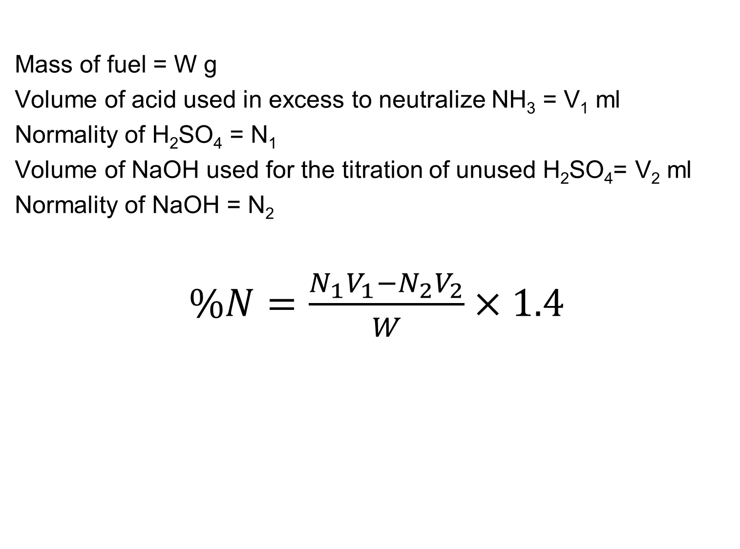

Slide 51
Determination of S:
m
S+ O₂ SO₂ H₂SO₄
BaCl₂
BaSO₄
(z gm)
S BaSO₄
32 gm 233 gm

Slide 52
% of S = Wt of BaSO₄ ppt x 32 x 100
Wt of coal sample taken x 233
% of Oxygen = 100-(% of all other elements)

Slide 53
PROBLEM
1.0g of a sample of coal was used for nitrogen estimation by Kjeldahl method. The evolved ammonia was collected in 25ml N/10 sulfuric acid. To neutralize excess acid, 15ml of 0.1N sodium hydroxide was required. Determine the percentage of nitrogen in the given sample of coal.
ANSWER
1.4%

Slide 54
DETERMINATION OF S:
S+ O₂ SO₂
SO₂ + H₂O H₂SO₄
% of S = wt of BaSO₄ formed x 32 x 100
wt of coal sample x 233
(iv) DETERMINATION OF ASH:
by proximate analysis

Slide 55
(V) DETERMINATION OF O:
% of O = 100 - % of (C + H + N + S + ash)

Slide 56
PROBLEM
0.5 g of sample of coal was used in a bomb calorimeter for the determination of calorific value. Calorific value of coal was found to be 8,600 cal/g. The ash formed in the bomb calorimeter was extracted with acid and the acid extract was heated with barium nitrate solution and a precipitate of barium sulphate was obtained. The precipitate was filtetred, dried and weighed. The weight of precipitate was found to be 0.05 g. Calculate the % of S in the coal sample.
ANSWER
1.37%

Slide 57
KNOCKING
The metallic sound produced due to the irregular burning of the fuel.
Causes loss in power of engine.
Reason: Mistimed ignition due to increase in temperature of the cylinder resulting from the heat of compression.
Knocking α 1 α 1
Octane number Fuel efficiency
Knocking among different categories of compounds:
Straight chain paraffins > branched chain paraffins > olefins > naphthenes > aromatics.
Notes:
The mixture known as gasoline or petrol, when used in high compression internal combustion engines, has a tendency to knock (also called "pinging" or "pinking") and/or to ignite early before the correctly timed spark occurs (pre-ignition, refer to engine knocking
‹#›

Slide 58
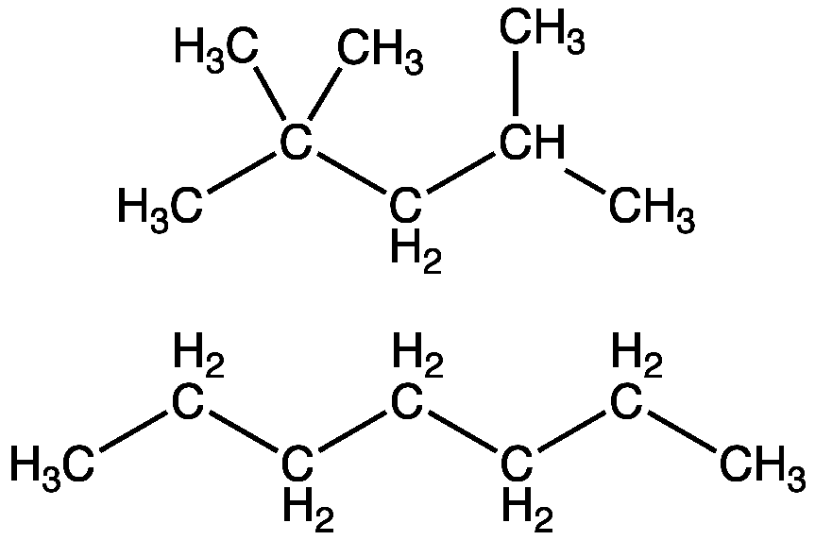
OCTANE NUMBER
O.N. signifies the ignition quality of gasoline in automobile engines.
For grading gasoline(Petrol)
Isooctane = 100
n-heptane = 0
Definition: It indicates the % by volume of isooctane in a mixture of isooctane and n-heptane which exhibits same characteristics of the fuel in a standard engine under a set of operating conditions.
More the octane number, better the fuel efficiency.
Notes:
octane number, is a standard measure of the performance of an engine or aviation fuel
higher the octane number, the more compressionhigher the octane number, the more compression the fuel can withstand before detonating (igniting). In broad terms, fuels with a higher octane rating are used in high performance gasoline engineshigher the octane number, the more compression the fuel can withstand before detonating (igniting). In broad terms, fuels with a higher octane rating are used in high performance gasoline engines that require higher compression ratioshigher the octane number, the more compression the fuel can withstand before detonating (igniting). In broad terms, fuels with a higher octane rating are used in high performance gasoline engines that require higher compression ratios. In contrast, fuels with lower octane numbers (but higher cetane numbershigher the octane number, the more compression the fuel can withstand before detonating (igniting). In broad terms, fuels with a higher octane rating are used in high performance gasoline engines that require higher compression ratios. In contrast, fuels with lower octane numbers (but higher cetane numbers) are ideal for diesel engineshigher the octane number, the more compression the fuel can withstand before detonating (igniting). In broad terms, fuels with a higher octane rating are used in high performance gasoline engines that require higher compression ratios. In contrast, fuels with lower octane numbers (but higher cetane numbers) are ideal for diesel engines, because diesel engines (also referred to as compression-ignition engines) do not compress the fuel, but rather compress only air and then inject fuel into the air which was heated by compression. Gasoline engines rely on ignition of air and fuelhigher the octane number, the more compression the fuel can withstand before detonating (igniting). In broad terms, fuels with a higher octane rating are used in high performance gasoline engines that require higher compression ratios. In contrast, fuels with lower octane numbers (but higher cetane numbers) are ideal for diesel engines, because diesel engines (also referred to as compression-ignition engines) do not compress the fuel, but rather compress only air and then inject fuel into the air which was heated by compression. Gasoline engines rely on ignition of air and fuel compressed together as a mixture, which is ignited at the end of the compression strokehigher the octane number, the more compression the fuel can withstand before detonating (igniting). In broad terms, fuels with a higher octane rating are used in high performance gasoline engines that require higher compression ratios. In contrast, fuels with lower octane numbers (but higher cetane numbers) are ideal for diesel engines, because diesel engines (also referred to as compression-ignition engines) do not compress the fuel, but rather compress only air and then inject fuel into the air which was heated by compression. Gasoline engines rely on ignition of air and fuel compressed together as a mixture, which is ignited at the end of the compression stroke using spark plugshigher the octane number, the more compression the fuel can withstand before detonating (igniting). In broad terms, fuels with a higher octane rating are used in high performance gasoline engines that require higher compression ratios. In contrast, fuels with lower octane numbers (but higher cetane numbers) are ideal for diesel engines, because diesel engines (also referred to as compression-ignition engines) do not compress the fuel, but rather compress only air and then inject fuel into the air which was heated by compression. Gasoline engines rely on ignition of air and fuel compressed together as a mixture, which is ignited at the end of the compression stroke using spark plugs. Therefore, high compressibility of the fuel matters mainly for gasoline engines. Use of gasolinehigher the octane number, the more compression the fuel can withstand before detonating (igniting). In broad terms, fuels with a higher octane rating are used in high performance gasoline engines that require higher compression ratios. In contrast, fuels with lower octane numbers (but higher cetane numbers) are ideal for diesel engines, because diesel engines (also referred to as compression-ignition engines) do not compress the fuel, but rather compress only air and then inject fuel into the air which was heated by compression. Gasoline engines rely on ignition of air and fuel compressed together as a mixture, which is ignited at the end of the compression stroke using spark plugs. Therefore, high compressibility of the fuel matters mainly for gasoline engines. Use of gasoline with lower octane numbers may lead to the problem of engine knocking.^{[1]}
‹#›

Slide 59
Reasons for opting the blend of iso-octane & n-heptane:
The different hydrocarbon in gasoline:
Straight chain paraffin
Iso-paraffins
Naphthenes
Aromatics
For the same Carbon No; straight chain paraffin have lowest octane No.
Branched chain paraffin (isomers), Naphthenes have higher octane No.
Olefins also have high O.N. but they cause gum deposits in the fuel tank and are not desirable.
Aromatic have high O.N. but their content is being restricted due to their carcinogenic nature.

Slide 60
Octane numbers of few hydrocarbons:
Carbon | Hydrocarbon | Octane No.
C₆ – Straight chain | n- Hexane | 28.8
C₆ – Isomer | Methyl Pentane | 73.4
C₆ – Isomer | Dimethyl Butane | 91.8
C₆ – Napthenes | Cyclohexane | 83
C₆ – Aromatic | Benzene | 98
C₇ – Paraffin | n - Heptane | 0
C₇ – Isomer | Dimethyl Pentane | 88
C₈ – Isomer | Iso – Octane | 100
C₇ – Aromatics | Toluene | 107

Slide 61
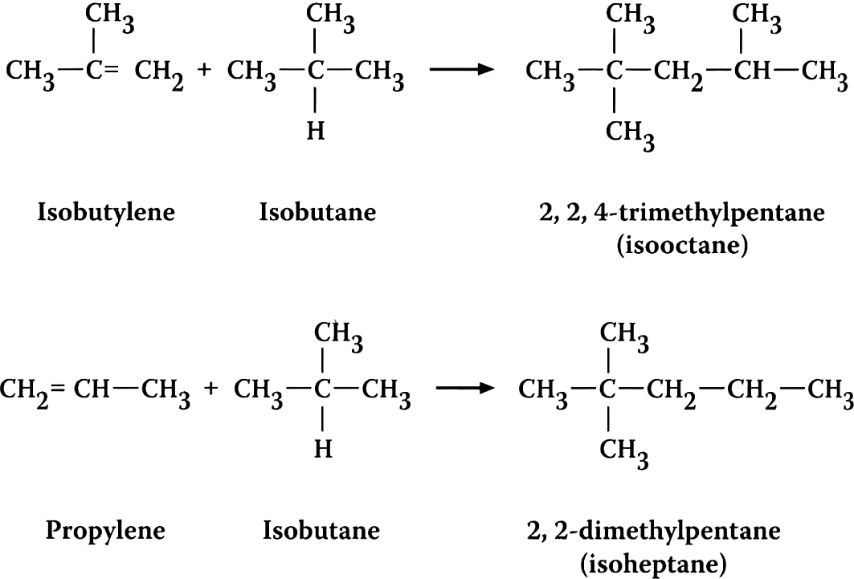
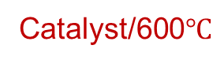
Methods to increase octane number:
By adding the antiknocking agent: e.g. TEL (about 1.0-3.0 ml /gallon petrol) along with some ethylene dibromide.
By isomerisation
By alkylation
By aromatisation
CH₃CH₂CH₂CH₃ (CH₃)₃CH
(CH₃)₂CHCH₂CH₂CH₃ (CH₃)₂CHCH(CH₃)₂ + (CH₃)₃C-CH₂CH₃
CH₃ (CH₂)₆CH₃ (CH₃)₂CH(CH₂)₄CH₃
(ON = -19) (ON = 100)
AlCl₃ / HCl / ∆
C₆H₁₄ C₆H₆
C₇H₁₆ C₆H₅CH₃
Catalysts: Cr₂O₃/Al₂O₃ or CrO₃/Pt.
Notes:
The octane no. for a gasoline fuel can be increased by adding Tetraethyl lead (TEL)
But
Addition of it causes spark plug fouling so Ethylene Dibromide is used instead to avoid lead deposits around the spark plug.
‹#›

Slide 62
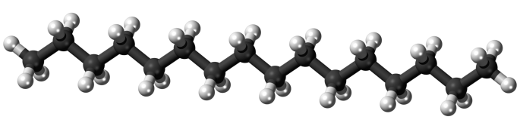
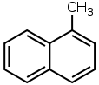
CETANE NUMBER
For grading diesel oil
Normal paraffin's have highest cetane no. followed by naphthenes, isoparaffins, olefins and aromatics.
For grading diesel oil.
Hexadecane (cetane) = 100
α- methyl naphthalene = 0
The % of cetane present in the mixture of cetane and α-methyl naphthalene which has the same ignition property as the fuel itself.
More the cetane number, better the fuel efficiency.
C₁₆H₃₄
Notes:
Cetane number (or CN) is an inverse function of a fuel's ignition delay, and the time period between the start of injection and the first identifiable pressure increase during combustion of the fuel. In a particular diesel engine, higher cetane fuels will have shorter ignition delay periods than lower Cetane fuels. Cetane numbers are only used for the relatively light distillate diesel oils
an indicator of the combustionan indicator of the combustion speed of diesel fuelan indicator of the combustion speed of diesel fuel and compression needed for ignition
‹#›

Slide 63
Fractional Distillation of Petroleum

Slide 64
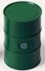
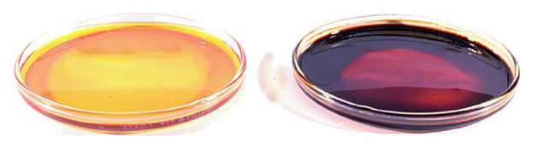
Petroleum
Light Sweet Crude Oil
Heavy Sweet Crude Oil
Petroleum is a mixture of thousands
of different types of hydrocarbons.
Notes:
Sweet crude oil is a type of petroleum is a type of petroleum. The New York Mercantile Exchange is a type of petroleum. The New York Mercantile Exchange designates petroleum with less than 0.42% sulfur as sweet.^{[1]} Petroleum containing higher levels of sulfur is called sour crude oil.
Light crude oil is liquid petroleum is liquid petroleum that has a low density is liquid petroleum that has a low density and flows freely at room temperature.^{[1]} It has a low viscosity It has a low viscosity, low specific gravity It has a low viscosity, low specific gravity and high API gravity It has a low viscosity, low specific gravity and high API gravity due to the presence of a high proportion of light hydrocarbon It has a low viscosity, low specific gravity and high API gravity due to the presence of a high proportion of light hydrocarbon fractions.^{[2]} It generally has a low wax It generally has a low wax content. Light crude oil receives a higher price It generally has a low wax content. Light crude oil receives a higher price than heavy crude oil It generally has a low wax content. Light crude oil receives a higher price than heavy crude oil on commodity markets It generally has a low wax content. Light crude oil receives a higher price than heavy crude oil on commodity markets because it produces a higher percentage of gasoline It generally has a low wax content. Light crude oil receives a higher price than heavy crude oil on commodity markets because it produces a higher percentage of gasoline and diesel fuel It generally has a low wax content. Light crude oil receives a higher price than heavy crude oil on commodity markets because it produces a higher percentage of gasoline and diesel fuel when converted into products It generally has a low wax content. Light crude oil receives a higher price than heavy crude oil on commodity markets because it produces a higher percentage of gasoline and diesel fuel when converted into products by an oil refinery.
‹#›

Slide 65
Where We Get Oil?
The world's top five crude oil-producing countries are:
Saudi Arabia
Russia
United States
Iran
China

Slide 66
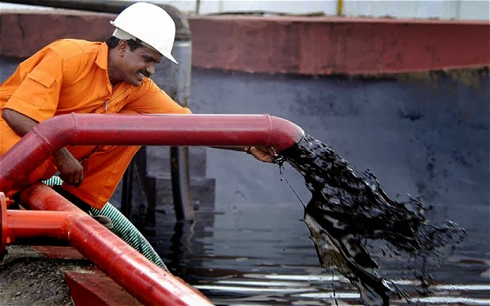
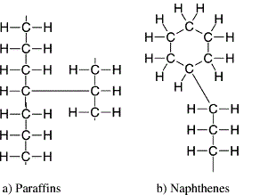
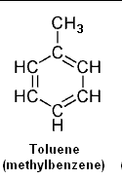
Petroleum Hydrocarbon Structures
Paraffins
Aromatics
Naphthenes
Notes:
Naphthenes: These are cyclo-paraffins and although this example of cyclohexaneNaphthenes: These are cyclo-paraffins and although this example of cyclohexane looks like a benzene molecule there are no double bonds within the ring and so every carbon (in this example) has 2 hydrogen atoms bonded to it. Cyclohexane has an interesting boat or chair configuration.
‹#›

Slide 67
Composition of petroleum
C : 80-87%
H : 15%
S,N,O : 1%
Notes:
‹#›

Slide 68
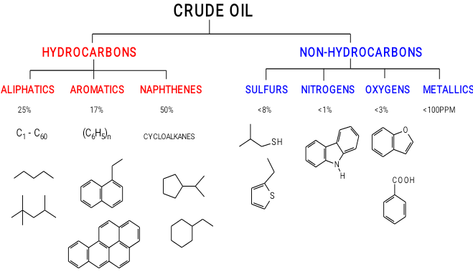

Composition of Crude Oil

Slide 69
Fractional Distillation of Petroleum
Petroleum can be separated into different fractions by fractional distillation.
This separation can take place because petroleum is a mixture of substances with different boiling points.

Slide 70
Conditions for Oil Refining
Petroleum is heated to 360°C in the absence of air in a furnace to vaporize it before fractional distillation.

Slide 71

Question
tWhy is petroleum vaporized in the absence of air at 360°C?
It may ignite and cause an explosion!

Slide 72
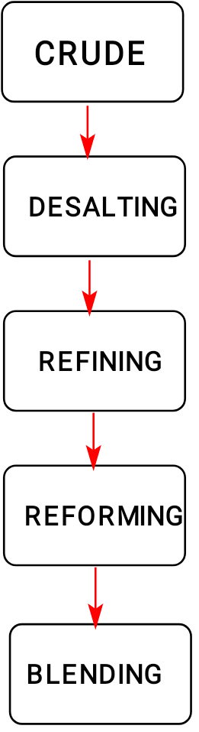
Petroleum delivered from well field
Water washing to remove impurities
Distillation to separate by boiling point ranges
Conversion reactions to alter molecular structures
Mixing to obtain maximum commercial characteristics

Slide 73
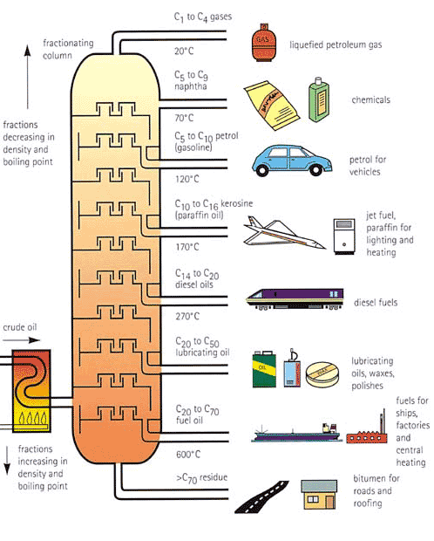
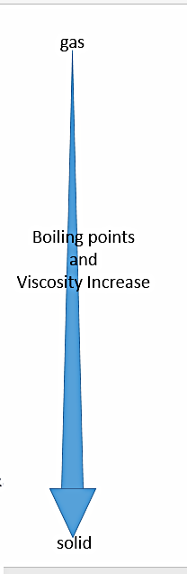

Slide 74
FLASH POINT
The flash point of a volatile liquid is the lowest temperature at which it can vaporise to form an ignitable mixture in air.
At the flash point, the vapour may cease to burn when the source of ignition is removed.
Or
The minimum temperature, at which the sample gives sufficient vapours, which forms an ignition mixture with air, giving a flash when a flame is applied to it, is called flash point.

Slide 75
FIRE POINT
A slightly higher temperature, the fire point, is defined as the temperature at which the vapour continues to burn after being ignited.

Slide 76
PREPARATION OF ALKANES
By the reduction of unsaturated hydrocarbons
RCH=CH₂ + H₂ RCH₂CH₃
By Wurtz reaction
2RCH₂X + 2Na RCH₂CH₂R
From Grignard Reagent
RMgX +H₂O → RH + Mg(X)OH
Kolbe’s electrolytic method
2RCOONa 2RCOO⁻ + 2Na⁺
(At anode) (At cathode)
2Na⁺ 2Na 2NaOH + H₂
2RCOO⁻ 2RCOO˙ 2R˙ R-R
Ni
Ether / ∆
Current
+2e⁻
H₂O
-2e⁻
-2CO₂
Coupling
Notes:
The reaction consists of a halogen-metal exchange involving the radicalThe reaction consists of a halogen-metal exchange involving the radical species R• (in a similar fashion to the formation of a Grignard reagentThe reaction consists of a halogen-metal exchange involving the radical species R• (in a similar fashion to the formation of a Grignard reagent) with carbon–carbon bond formation occurring in a nucleophilic substitution reaction.
One electron from the metal is transferred to the halogen to produce a metal halide and an alkyl radical.
R–X + M → R• + M⁺X⁻The alkyl radical then accepts an electron from another metal atom to form an alkyl anion. This intermediate has been isolated in several cases.
R• + M → R⁻M⁺The nucleophilic carbon of the alkyl anion then displaces the halide in an S_{N}2 reaction, forming a new carbon-carbon covalent bond.
R⁻M⁺ + R–X → R–R + M⁺X⁻
‹#›

Slide 77
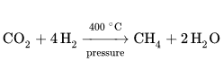
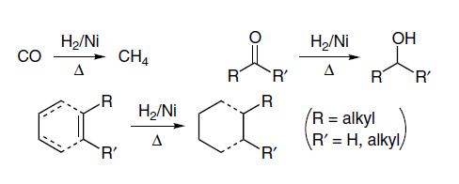
Sabatier reaction
The Sabatier reaction or Sabatier process was discovered by the French chemist Paul Sabatier in the 1910s. It involves the reaction of hydrogen with carbon dioxide at elevated temperatures (optimally 300–400 °C) and pressures in the presence of a nickel catalyst to produce methane and water. Optionally, ruthenium on alumina (aluminium oxide) makes a more efficient catalyst.
Sabatier and Senderen Reduction

Slide 78
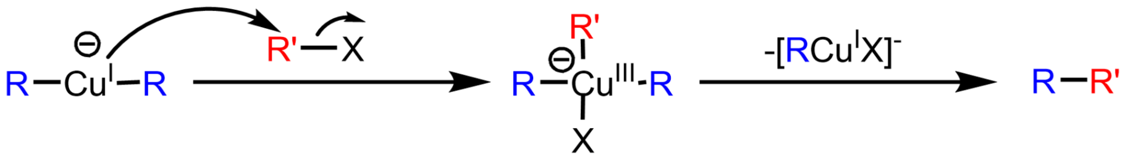
From sodium salt of carboxylic acids.
RCOOH + NaOH → RCOONa + H₂O
RCOONa RH + Na₂CO₃
By the reduction of alkyl halides.
RI RH + I₂
By the hydroboration of alkenes
RCH=CH₂ RCH₂CH₃
Corey-House Synthesis
RCl + 2Li RLi + LiCl
2RLi + CuCl R₂CuLi + LiCl
R₂CuLi RR’ + RCu + LiCl
Soda lime
HI, P
B₂H₆ / THF / Propionic acid (reflux)
Ether
R’X

Slide 79
PHYSICAL PROPERTIES OF ALKANES
Lower members gases, in-between liquids and higher waxy solids.
Non-polar in nature, less denser than water.
Immiscible with water making two layers but soluble in organic solvents.
Regular increases in boiling and melting points with molecular weight.
Specific gravity increases with increase in molecular weight.

Slide 80
CHEMICAL PROPERTIES OF ALKANES
Combustion.
C_{n}H_{2n+2} + (3n+1/2) O₂ → (n+1) H₂O + nCO₂
Free radical substitution reactions.
Nitration.
RCH₂R’ + HNO₃ RNO₂ + R’CH₂NO₂ + R’NO₂ + RCH₂NO₂ + RCH(NO₂)R’
Halogenation.
CH₄ CH₃Cl CH₂Cl₂ CHCl₃ CCl₄
Sulfonation.
RH + H₂SO₄ → RSO₃H + H₂O
450°C
Cl₂/UV light
Cl₂/UV light
Cl₂/UV light
Cl₂/UV light

Slide 81
Cracking (Pyrolysis)
CH₃-CH₃ CH₂=CH₂ + H₂
CH₃CH₂CH₃ CH₃CH=CH₂ + H₂
CH₂=CH₂ + CH₄
CH₃CH₂CH₂CH₃ CH₃CH₂CH=CH₂ + H₂
CH₃CH=CH₂ + CH₄
CH₃-CH₃ + CH₂=CH₂
*Used for preparing high octane gasoline
C₄H₁₀ +C₄H₈ C₈H₁₈
Isooctane
Isomerisation
CH₃CH₂CH₂CH₃ (CH₃)₃CH
(CH₃)₂CHCH₂CH₂CH₃ (CH₃)₂CHCH(CH₃)₂ + (CH₃)₃C-CH₂CH₃
CH₃ (CH₂)₆CH₃ (CH₃)₂CH(CH₂)₄CH₃
(ON = -19) (ON = 100)
∆/-nce of air
∆/-nce of air
∆/-nce of air
catalyst
AlCl₃ / HCl / ∆
AlCl₃ / HCl / ∆
AlCl₃ / HCl / ∆

Slide 82
Aromatisation.
C₆H₁₄ C₆H₆
C₇H₁₆ C₆H₅CH₃
C₈H₁₈ C₆H₅-CH₂CH₃ + o-xylene + m-xylene + p-xylene
* Catalysts: Cr₂O₃/Al₂O₃ or CrO₃/Pt.
Oxidation.
With Cu at 200°C & 100 atm. : Alcohols.
With MnO at 200°C : Carboxylic acids.
With Mn(OAc)₂ : Carboxylic acids.
With alkaline KMnO₄ : Tertiary alcohols.
Catalyst / 600°C
Catalyst / 600°C
Catalyst / 600°C

Slide 83
CHARACTERISTICS OF
UNSATURATED HYDROCARBONS
General formula C_{n}H_{2n}.
Presence of double or triple bonds in between different carbon atoms.
Straight or branched chain molecules.
sp² hybridized.
Trigonal planar in shape.

Slide 84
PREPARATION OF ALKENES
By the dehydration of alcohols.
C₂H₅OH CH₂=CH₂ + H₂O
CH₃CH₂CH₂OH CH₃CH=CH₂ + H₂O
(CH₃)₃COH (CH₃)₂C=CH₂
(*Elimination according to Saytzeff’s rule).
By the dehydrohalogenation of alkyl halides.
CH₃CH₂Br CH₂=CH₂ + Br⁻ + H₂O
By the dehalogenation of vicinal dihalides.
CH₂Br-CH₂Br CH₂=CH₂ + ZnBr₂
H₂SO₄ / 160°C
H₂SO₄ / 180°C
H₂SO₄ / 85°C
Alc. KOH / ∆
Zn dust

Slide 85
By Cracking.
CH₃-CH₂-CH₂-CH₃ CH₄ + CH₂=CH-CH₃
CH₂=CH₂ + CH₃CH₃
By the controlled hydrogenation of alkynes.
RC≡CH + H₂ RCH=CH₂
∆
Pd-CaCO₃ / quinoline

Slide 86
CHARACTERISTICS OF
UNSATURATED HYDROCARBONS
General formula C_{n}H_{2n}.
Presence of double or triple bonds in between different carbon atoms.
Straight or branched chain molecules.
sp² hybridized.
Trigonal planar in shape.

Slide 87
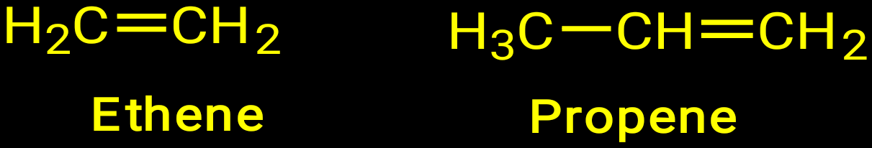



ALKENES
Contain one or more double bonds in between different carbon atoms.
Named by adding suffix ‘ene’ to the root word.
1-Butene
1-Pentene
1-Hexene
1,3-Butadiene
3-methyl-1,4-pentadiene

Slide 88
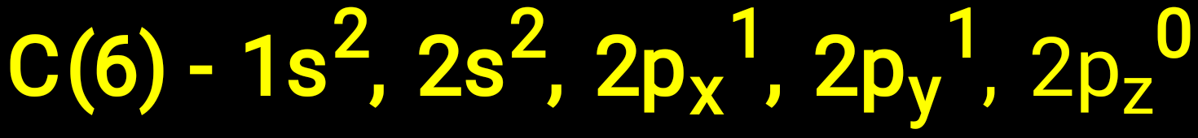

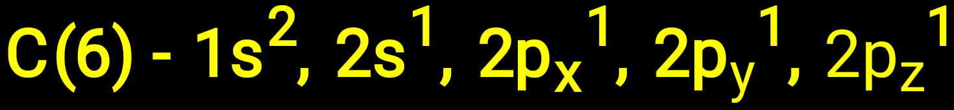

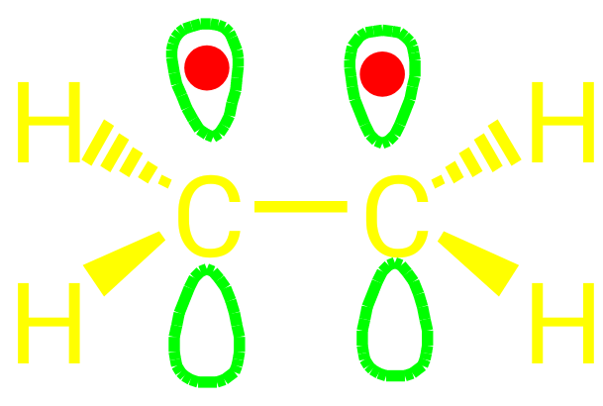
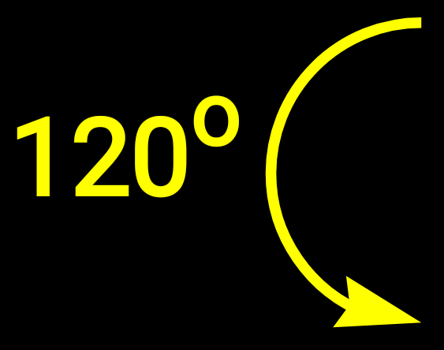
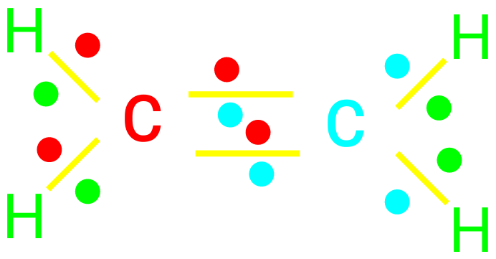

sp²
π-bond
Three σ-bonds
σ-bonds – One C-C, two C-H bonds per carbon atom
Flat molecule – “Planar”
π-bond
Notes:
‹#›

Slide 89
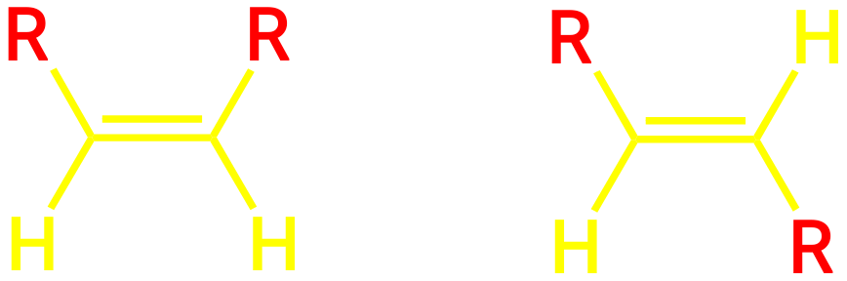
ISOMERISM
Groups or atoms can be rotated about a single bond, but double bond is rigid – No rotation about a double bond is possible without breaking the π-bond, leading to cis-trans or E-Z isomerism.
cis-
trans-
*Geometric isomers have different chemical & physical properties

Slide 90
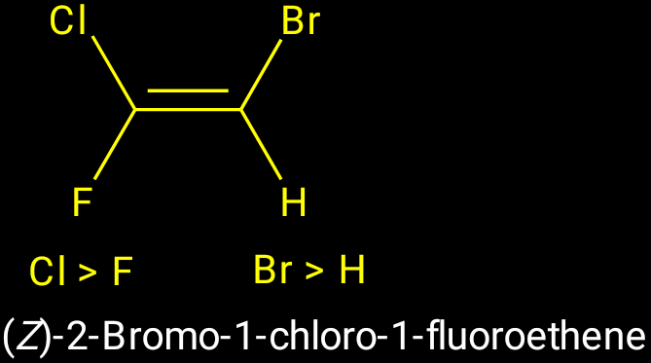
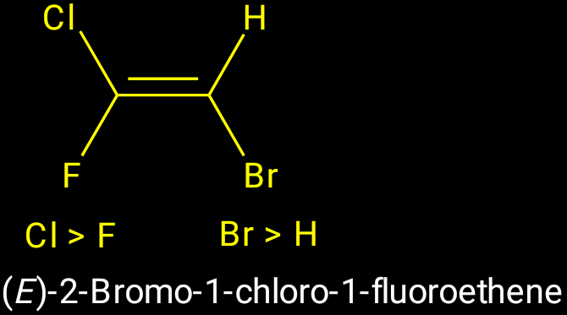
Z-E system, we take the group with higher priority (here higher molecular weight), and compare it with the group with higher priority on the other carbon.
Notes:
‹#›

Slide 91
PHYSICAL PROPERTIES OF ALKENES
First three members: gases at ordinary temperature; next fourteen liquids; rest solids.
Slightly soluble in water; freely soluble in organic solvents.
M.P., B.P. and specific gravity rise with increase in molecular weight.

Slide 92
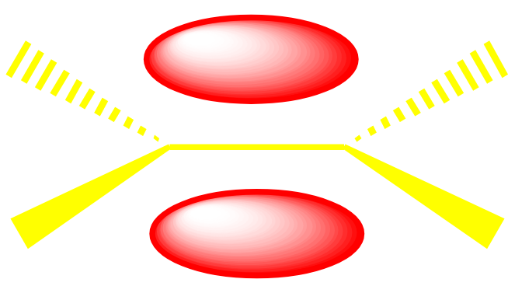

CHEMICAL PROPERTIES OF ALKENES
Highly reactive.
p-bond lobes represent areas of high electron density.
Therefore, the p-bond is susceptible to attack by electron deficient molecules, called electrophiles, E⁺
E⁺
Most important type of reactions is ‘Addition reactions’.

Slide 93
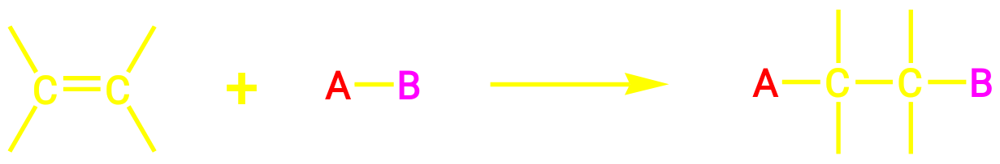
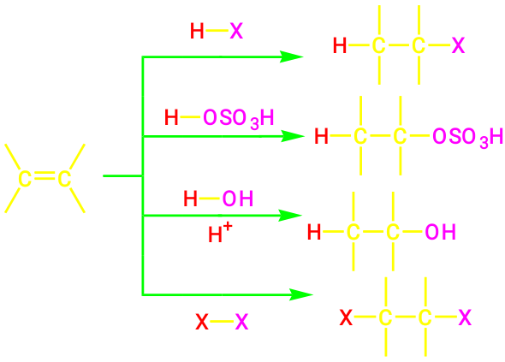
1. ADDITION REACTIONS
Addendum
Alkyl Halides
Alkyl hydrogen Sulfate
Alcohols
Dihaloalkanes
(Test for unsaturation)

Slide 94


Mechanism of Addition reactions on C=C
Ionic mechanism. Always Electrophilic addition
*The electrophile is a Lewis acid, i.e. it accepts a pair of electrons,
while nucleophile is a Lewis base, its donated a pair of electrons.
Step I: Attack of electrophile
The Slow Step is the Rate Determining Step
Step II: Attack of nucleophilic part of the addendum.

Slide 95

Anti-Markovnikov’s Rule / Peroxide Effect / Khharasch Effect: Addition reversed in the +nce of peroxides.
CH₃CH₂CH₂Br
CH₃-CH=CH₂ + HBr
CH₃CHBrCH₃
(*Proceeds via free radical mechanism).
Markovnikov’s Rule:
+ve part of the addendum goes to that carbon atom which already contains the maximum number of H atoms.
Unsymmetrical Alkene
Peroxide
No peroxide

Slide 96

(i) Addition of sulfuric acid
Notes:
‹#›

Slide 97




(ii) Addition of Halogen acids
2-Bromopropane
(Major product)
2º Carbocation prefered
1-Bromopropane (Minor product)
1º Carbocation
3º > 2º > 1º
Carbocation stability
Notes:
‹#›

Slide 98


(iii) Bromination
Formation of cyclic intermediate.
Back-side nucleophilic attack of bromide ion: opening of three membered ring.
*Stereospecific Product
Notes:
‹#›

Slide 99

(iv) Hydrogenation – “Reduction”
Notes:
‹#›

Slide 100
(v) Addition of Hypohalous acid.
CH₂=CH₂ + HOX → HOCH₂-CH₂X
Halohydrin
2. Oxidation.
With cold KMnO₄ solution: Glycols.
RCH=CHR + KMnO₄ RCH(OH)-CH(OH)R
Glycol
With hot KMnO₄ solution: Carboxylic acids or ketones.
RCH₂-CH=CH₂ RCH₂COOH + CO₂ + H₂O
R₂C=CHR R₂CO + RCOOH
(iii) Catalytic: Epoxides.
RCH=CHR + O₂ RCH-CHR
O
H₂O
[O] / Hot KMnO₄
[O] / Hot KMnO₄
Ag / ∆

Slide 101
(iv) With Ozone: Aldehydes and ketones.
R₂C=CHR R₂CO + RCHO
RCH=CHR’ RCOOH + R’COOH
3. Combustion.
CH₂=CH₂ + 3O₂ → 2CO₂ + 2H₂O
4. Polymerisation:
O₃ / Zn-H₂O
O₃ / H₂O₂
Large molecules containing many identical repeating units (100- 1000000).
Condensation Polymerisation: A by-product is eliminated along with the formation of polymer.
Addition polymer: Monomer simply add together to give the polymer without elimination of by-product.

Slide 102


Slide 103
5. Substitution by Halogen: Allylic substitution in the presence of halogen at high temperature.
RCH₂-CH=CH₂ + X₂ R(X)CH-CH=CH2
6. Hydroboration:
500°C
B₂H₆ / THF / Propionic acid (reflux)
RCH=CH₂ RCH₂CH₃

Slide 104


ALKYNES
2sp
2π−bonds
Two s-bonds (C-H) and (C-C) and Two p-bonds between C-C per C atom
Linear Molecule

Slide 105
CHARACTERISTICS OF ALKYNES
General formula C_{n}H_{2n-2}.
Presence of triple bond, containing one σ and two Π-bond.
The two p-bonds are perpendicular to each other and form a cylinder of negative charge about the axis of the bond ---------- No bond rotation about triple bond.
sp-orbitals contain 50% s- and 50% p-character.
The carbon-carbon bond is 1.2Aº shorter than C=C, which is 1.3Aº. C-H bond is also shorter than ethene, which is shorter than ethane.
The bonding electrons reside closer to the C-nucleus, and so are held more tightly.
Notes:
‹#›

Slide 106
PREPARATION OF ALKYNES
From calcium carbide:
CaC₂ + 2H₂O → HC≡CH + Ca(OH)₂
2. From dehydrohalogenation of vicinal dihalides:
CH₃CHBrCH₂Br + 2KOH → CH₃C≡CH + 2KBr + 2H₂O
RCH₂CHBrCH₂Br + 2NaNH₂ RCH₂C≡CH + 2NaBr + 2NH₃
(*KOH helps in isomerisation).
3. From ketones.
RCOCH₂R’ RC(X₂)CH₂R’ RC≡CR’ + 2HCl
4. By the displacement reaction.
RC≡CH RC≡C⁻Na⁺ RC≡CR’ + NaX
5. From tetrahalides.
RCX₂-CX₂R + 2Zn → RC≡CR + 2ZnCl₂
150°C
PX₅
Alc. KOH
NaNH₂
R’X

Slide 107
PHYSICAL PROPERTIES OF ALKYNES
First three members gases; next eight liquids; higher solids.
Slightly soluble in water; soluble in organic solvents.
B.P., M.P., density increase with increase in molecular weight.

Slide 108
CHEMICAL PROPERTIES OF ALKYNES
1. Addition reactions:
Reduction.
RC≡CH RCH=CH₂ RCH₂CH₃
R R
RC≡CR C=C
H H
cis-alkene
R H
C=C
H R
trans-alkene
Alkynes are more reactive in halogenation reactions than alkenes.
H₂, Ni
H₂, Ni
H₂, Pd / BaSO₄
Quinoline
Na / NH₃

Slide 109
(ii) Addition of Halogens.
RC≡CR RCX=CXR RCX₂-CX₂R
(iii) Addition of Hydrogen Halides.
RC≡CH RCX=CH₂ RCX₂CH₃
2. Hydration.
HC≡CH + H₂O CH₃CHO
RC≡CH RC(OH)=CH₂ RCOCH₃
3. Addition of HCN.
HC≡CH + HCN CH₂=CHCN
X₂ / CCl₄
X₂ / CCl₄
HX (g)
HX (g)
40% H₂SO₄
Hg⁺⁺ / 190°C
H₂O, H₂SO₄
Hg⁺⁺
CuCl in HCl

Slide 110
4. Reaction with metals.
RC≡CH + NaNH₂ → RC≡C⁻Na⁺ + NH₃
RC≡C⁻Na⁺ + R’Br → RC≡CR’ + NaBr
RC≡CH + AgNO₃ + NH₄OH → RC≡CAg + H₂O + NH₄NO₃
2RC≡CH + Cu₂Cl₂ + 2NH₄OH → 2RC≡CCu + 2H₂O + 2NH₄Cl
RC≡CH + CH₃MgBr → RC≡CMgBr + CH₄
5. Ozonization.
RC≡CH RCOOH + CO₂
RC≡CR’ RCOOH + R’COOH
RC≡CR’ RCOCOR’
6. Oxidation.
RC≡CH + 4[O] RCOOH + CO₂
RC≡CR’ + 4[O] RCOOH + R’COOH
O₃ / H₂O
O₃ / H₂O
O₃ / Neutral KMnO₄
Alkaline KMnO₄
Alkaline KMnO₄

Slide 111
7. Isomerization.
RCH₂CH₂C≡CH RCH₂C≡CCH₃
RCH₂C≡CCH₃ RCH₂CH₂C≡C⁻Na⁺ RCH₂CH₂C≡CH
8. Polymerization.
2CH≡CH CH₂=CH-C≡CH
2RC≡CH RC≡C-C≡C-R
3CH≡CH C₆H₆
3CH₃C≡CH 1,3,5-Trimethylbenzene
Applications: Acetylene in welding and illuminant.
Precursors of synthetic fibres and polymers.
Alc. KOH
NaNH₂
H₂O / H⁺
CuCl, NH₄Cl
CuCl, NH₄Cl
600-700°C
Ni(CN)₂, (C₆H₅)₃P
Red hot iron tube

Slide 112








ALICYCLIC COMPOUNDS / NAPHTHENES
Cyclic and aliphatic in nature.
General formula C_{n}H_{2n} (n is a whole number usually from 1 to 20).
Isomeric with alkenes.
Ring structures are monocyclic to Polycyclic combinations.
Cyclopropane
Cyclobutane
Cyclopentane

Slide 113




SHAPES OF CYCLOALKANES
Baeyer Strain theory.
Distorted shapes of molecules.
Cycloproane Cyclobutane Cyclopentane
(Bond angle 60°) (Bond angle 88°) (Bond angle 108°)
Cyclohexane
(Bond angle 109.28°)

Slide 114
STABILITY OF CYCLOALKANES
Given by Adolf Baeyer in 1885 as ‘Baeyer Strain threory’.
Larger the angle strain, lesser is the stability.
Compound Bond Angle Angle Strain
Cyclopropane 60° 24.44°
Cyclobutane 90° 9.44°
Cyclopentane 108° 0.44°
Cyclohexane 120° -5.16°
Notes:
‹#›

Slide 115



PREPARATION OF CYCLOALKANES
By the reaction of ω-dihalogen derivatives with sodium.
XCH₂-CH₂-CH₂X + 2Na → + 2NaX
2. By the photolysis of cyclic ketones.
+ CO
3. By Clemmensen or Wolf-Kishner reduction.
4. By the reduction of aromatic hydrocarbons.
hυ
Zn -Hg/ HCl
NH₂NH₂ / KOH
H₂ / Ni

Slide 116

5. By the reduction of unsaturated alicyclic compounds.
6. By the insertion of carbene. R₂ R₂
R₂C=CR₂ + :CH₂ →
By Diels-Alder reaction.
+ ║ →
8. By Simmon-Smith reaction. R₂ R₂
R₂C=CR₂ + :CH₂I₂
H₂ / Ni
H₂ / Ni
Zn, Cu / ether

Slide 117
9. Malonic ester synthesis.
CH₂Br COOC₂H₅ COOC₂H₅
CH₂ + Na⁺CH⁻
CH₂Br COOC₂H₅ COOC₂H₅
COOH
COOH
10. From Grignard reagent.
Br MgBr
-2NaBr
H₂O
∆ / -2CO₂
Mg / ether
H₂O

Slide 118

11. From calcium salt of dicarboxylic acids.
CH₂CH₂COO⁻
Ca⁺²
CH₂CH₂COO⁻
12. Dieckmann reaction.
CH₂CH₂
COOC₂H₅
CH₂CH₂
COOC₂H₅ COOC₂H₅ COOH
∆ /-CaCO₃
[H]
Na
H₂O / H⁺
-C₂H₅OH
∆ / -CO₂
[H]

Slide 119
PHYSICAL PROPERTIES
First two members gases, rest liquids.
M.P., B.P. increase with increase in molecular weight.
Insoluble in water, soluble in organic solvents.

Slide 120
CHEMICAL PROPERTIES OF CYCLOALKANES
Ring Opening reactions.
CH₃CH₂CH₃
BrCH₂CH₂CH₂Br
CH₃CH₂CH₂Br
CH₃CH₂CH₃
2. Substitution reactions. X
+ X₂ + HX
H₂, Pd / C
Br_{2 (CCl4/dark)}
HBr
H₂, Ni , ∆
hυ

Slide 121
3. Oxidation.
CH₂CH₂COOH
CH₂CH₂COOH
5[O] / ∆
Alk. KMnO₄

Slide 122


AROMATICS
General formula: C₆H₅-Y (Y is a longer, straight molecule that connects to the benzene ring).
Ringed structures with one or more rings.
High carbon content: burns with smoky flame.
Cyclic.
Conjugation.
Planar structure.
Resonance.
Follow Huckel’s rule [Cyclic cloud of π-electrons with presence of (4n+2) π- electrons].
Show saturated behaviour.

Slide 123
C atoms are sp² hybrids, so that each C atom has one remaining p-electron involved in p-bonding
Three sp² hybrid orbitals at 120° to each other in a plane. The remaining p orbital is at right angles to them.
Each carbon atom uses the sp² hybrids to form s-bonds with two other carbons and one hydrogen atom.
Types: On the basis of presence of benzene ring:
1. Benzenoids 2. Non-benzenoids

Slide 124






1. Benzenoids: Containing at least one benzene ring.
Benzene Naphthalene Anthracene
2. Non-benzenoids: Containing no benzene ring.
Thiophene Pyrrole Furan

Slide 125



ANTI-AROMATIC COMPOUNDS
Contain a cyclic cloud of π-electrons which is having a total of 4n π- electrons.
Cyclobutadiene
NON-AROMATIC COMPOUNDS
Lack cyclic cloud of π- electrons.
Cyclopentadiene Cycloheptatriene

Slide 126

Naming Aromatic Hydrocarbons
Fluorobenzene
Ethylbenzene
Toluene
Aniline
Phenol
Benzoic Acid
o-/1,2-Dichlorobenzene
m-/1,3-Dichlorobenzene
o-Xylene
m-Bromostyrene
p-/1,4-Dichlorobenzene
2,4,6-Trinitrotoluene (TNT)
Notes:
‹#›

Slide 127
PREPARATION OF AROMATIC HYDROCARBONS
By heating the sodium salt of aromatic carboxylic acid in the presence of soda-lime.
C₆H₅COONa C₆H₆ + Na₂CO₃
By Friedel-Craft’s alkylation.
C₆H₆ + RX C₆H₅R
Aromatization.
Soda-lime / ∆
AlCl₃ / reflux
Catalyst / 600°C
C₆H₁₄ C₆H₆
C₇H₁₆ C₆H₅CH₃
C₈H₁₈ C₆H₅-CH₂CH₃ + o-xylene + m-xylene + p-xylene
Catalyst / 600°C
Catalyst / 600°C
* Catalysts: Cr₂O₃/Al₂O₃ or CrO₃/Pt.

Slide 128
4. By the reduction of aromatic ketones.
C₆H₅COR C₆H₅CH₂R
(* Reduction may by:
Clemmensen by using Zn-Hg / Conc. HCl or Wolf-Kishner by using NH₂NH₂ / KOH).
5. By Wurtz-Fittig reaction.
C₆H₅X + RX C₆H₅R + 2NaX
6. By the reaction of aromatic halide with dialkylcuprate.
C₆H₅X + R₂CuLi → C₆H₅R
7. By the polymerization of acetylene.
[H]
Na / ∆
600-700°C
3CH≡CH C₆H₆
Ni(CN)₂, (C₆H₅)₃P

Slide 129
8. By heating phenol with zinc dust.
C₆H₅OH + Zn C₆H₆ + ZnO
9. From Grignard reagent.
C₆H₅X + Mg C₆H₅MgX C₆H₆
∆
ether
H⁺ / H₂O

Slide 130
CHEMICAL PROPERTIES OF AROMATIC HYDROCARBONS
Reactivity is different to other unsaturated compounds- Substitution rather than Addition is favoured.
Substitution reactions: Electrophilic substitution.
C₆H₆ + E-Nu → C₆H₅-E + HNu
Halogenation.
C₆H₆ + X₂ C₆H₅X + HX
(ii) Nitration.
C₆H₆ C₆H₅NO₂
(iii) Sulfonation.
C₆H₆ C₆H₅SO₃H
anhy. AlCl₃
Conc. HNO₃ / Conc. H₂SO₄
Conc. H₂SO₄

Slide 131

(iv) Friedel-Craft;s reaction.
Alkylation.
C₆H₆ + RX C₆H₅R + HX
B. Acylation.
C₆H₆ + RCOX C₆H₅COR + HX
C₆H₆ + (RCO)₂O C₆H₅COR + RCOOH
2. Addition reactions.
Reduction.
+ 3H₂
anhy. AlCl₃
anhy. AlCl₃
anhy. AlCl₃
Ni , 180°, press.

Slide 132


(ii) Addition of halogens (Photoaddition).
+ 3Cl₂
3. Oxidation.
Ozonolysis.
C₆H₆ + 3O₃ → Triozonide 3CHO-CHO
(ii) Vapor phase oxidation.
+ 9O₂ + 4H₂O + 4CO₂
(iii) With alkaline KMnO₄.
C₆H₅CH₃ C₆H₅COOH
UV light
Zn / H₂O
V₂O₅ / 450°C
Alk. KMnO₄, H₂O / ∆

Slide 133

4. Chloromethylation.
C₆H₆ C₆H₅CH₂Cl
5. Gattermann-Koch reaction.
C₆H₆ + CO + HCl C₆H₅CHO
6. Gattermann aldehyde synthesis.
C₆H₆ + HCN + HCl C₆H₅CHO
7. Complexation.
+ ⇋
HCHO, HCl
ZnCl₂
AlCl₃
AlCl₃

Slide 134
RH
Paraffins
+ H₂
Napthenes Aromatics
Polynaphthenes Polynuclear Aromatics
Inter-relationship of various HCS
-H₂
- H₂
+H₂
- H₂
+H₂

Slide 135


Slide 136

Fisher-Tropsch method

Slide 137
Reforming
Reforming is a process which uses heat, pressure and a catalyst (usually containing platinum) to bring about chemical reactions which upgrade naphthas into high octane petrol and petrochemical feedstock.

Slide 138

Catalytic Reforming – Conversion Reactions

Slide 139


Slide 140
Cracking
Cracking processes break down heavier hydrocarbon molecules (high boiling point oils) into lighter products such as petrol and diesel. These processes include:
catalytic cracking
thermal cracking
hydrocracking

Slide 141


Slide 142
Alkylation
Alkylation refers to the chemical bonding of these light molecules with isobutane to form larger branched-chain molecules (isoparaffins) that make high octane petrol.

Slide 143


Slide 144
Isomerisation
Isomerisation refers to chemical rearrangement of straight-chain hydrocarbons (paraffins), so that they contain branches attached to the main chain (isoparaffins).

Slide 145
Polymerisation
Under pressure and temperature, over an acidic catalyst, light unsaturated hydrocarbon molecules react and combine with each other to form larger hydrocarbon molecules. Such process can be used to react butenes (olefin molecules with four carbon atoms) with iso-butane (branched paraffin molecules, or isoparaffins, with four carbon atoms) to obtain a high octane olefinic petrol blending component called polymer gasoline.

Slide 146
Hydrotreating
Hydrotreating is one way of removing many of the contaminants from many of the intermediate or final products. In the hydrotreating process, the entering feedstock is mixed with hydrogen and heated to 300 - 380ºC. The oil combined with the hydrogen then enters a reactor loaded with a catalyst which promotes several reactions:
hydrogen combines with sulphur to form hydrogen sulphide (H2S) .

Slide 147


Slide 148

Renewable Energy Sources

Slide 149


Slide 150


Slide 151


Slide 152


Slide 153




Slide 154


Slide 155


Slide 156


Slide 157


Slide 158
End of the module
You are advised to go through the tutorial problems
Any queries contact tgoswami@ddn.upes.ac.in
Note: Some images and materials are taken from different sources from Google and this is purely for educational purposes and not to be distributed anywhere other than where and whom it is intended for.

